Slide 1

Deep Learning Course
Supervisor: Shanup Peer
Student:
Joaquim Ezekiel (Student ID: 202201029)
DIAMOND PRICE PREDICTION PROJECT USING ANN

Slide 2
OUTLINE
Introduction
Data Description
Problem Statement
Methodology
Result & Conclusion

Slide 3
INTRODUCTION

Slide 4
INTRODUCTION
Deep learning has been successfully applied in many supervised learning settings. Traditional neural networks are applied for online advertising purposes. Convolutional neural networks (CNN) are great for photo tagging, and recurrent neural networks (RNN) are used for speech recognition or machine translation.
In recent years, our digital activity has significantly increased, generating very large amounts of data. While the performance of traditional machine learning methods will plateau as more data is used, large enough neural networks will see their performance increase as more data is available.
This project sees to clearly show clear understanding and applications of the taught concepts in the just concluded deep learning course. Dataset used for this project would be collected from the TensorFlow Dataset while focusing on structured dataset.

Slide 5
DATA DESCRIPTION

Slide 6
DATASET DESCRIPTION
For this purpose of this project, the Diamonds Dataset from the Structured dataset list would be used to clearly show understanding of the deep learning concepts. The Diamond dataset contains the prices and other attributes of almost 54,000 diamonds. The variables are as follows
Prices: the price of the diamond in US dollars ranging from $326 to $18,823
Carat: Carat weight of the diamond from 0.2 to 5.01
Cut: Describe cut quality of the diamond. Quality in increasing order Fair, Good, Very Good, Premium, Ideal
Color: Color of the diamond, with D being the best and J the worst color
Clarity: How obvious inclusions are within the diamond:(in order from best to worst, FL = flawless, I3= level 3 inclusions) FL, IF, VVS1, etc

Slide 7
DATASET DESCRIPTION
X: length in mm (0 to 10.74)
Y: width in mm (0 to 58.9)
Z: depth in mm (0 to 31.8)
Depth: The height of a diamond, measured from the culet to the table, divided by its average girdle diameter (43 to 79)
Table: The width of the diamond's table expressed as a percentage of its average diameter (43--95)

Slide 8
PROBLEM STATEMENT

Slide 9
WHAT PROBLEM ARE YOU LOOKING TO SOLVE?
In summary, the business problem here is to predict the prices of diamonds leveraging the different data features provided as well as Artificial Intelligence algorithm (Deep learning) to help businesses and customers makes informed decisions.
What is the dataset you will select?
As stated in my introduction, Diamond dataset from the TensorFlow datasets repository would be used for this project
What is the model you will build?
According to the course (Deep learning) that was taught, Artificial Neural Network would be used to build a regression model to predict the prices of diamond based on the historical data and label of our dataset.

Slide 10
METHODOLOGY

Slide 11
METHODOLOGY?
The steps that was be employed during the project is stated below:
Data Pre-processing: This first step involves importing relevant libraries and understanding the dataset using different python code functions. Defining the dependent and independent variables. In addition, the dataset is split into train and test dataset in which the train dataset is used to train the neural network model while the test data is used to check the efficiency of the built model by comparing the actual and predicted test data to ascertain the mean square error.
Building the Artificial Neural Network: The following takes places in this step.
Initializing the ANN
Adding the Input and the first output layer

Slide 12
METHODOLOGY?
Adding the second hidden layer
Adding the output layer
Training the Artificial Neural Network: The following takes places in this step.
Compiling the ANN
Training the ANN model on the training set
Parameters tuning to get the lowest possible mean square error by adjusting the parameters such as Activation Function, epoch, Dense units, optimizer, batch size etc
Predicting the result of the test set

Slide 13
RESULTS AND INSIGHTS

Slide 14
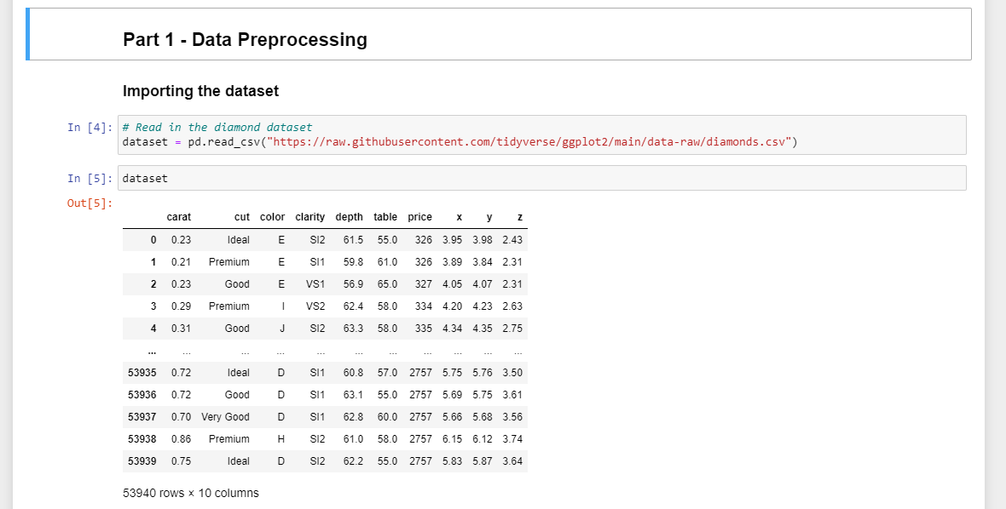
RESULTS & INSIGHTS
Data Pre-processing starts with importing relevant libraries and loading the dataset for modelling as seen on the image

Slide 15
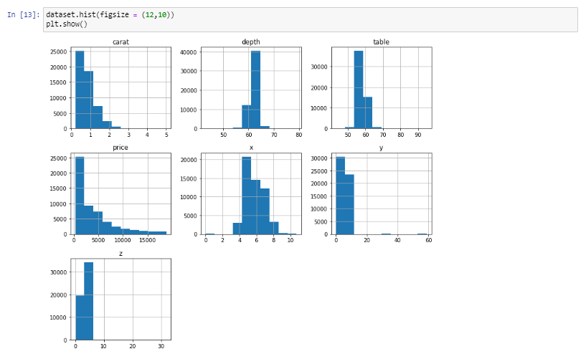
RESULTS & INSIGHTS
As part of data Pre-processing, we need to clearly understand the dataset we are working with,
The visual shows the distribution of the data features

Slide 16
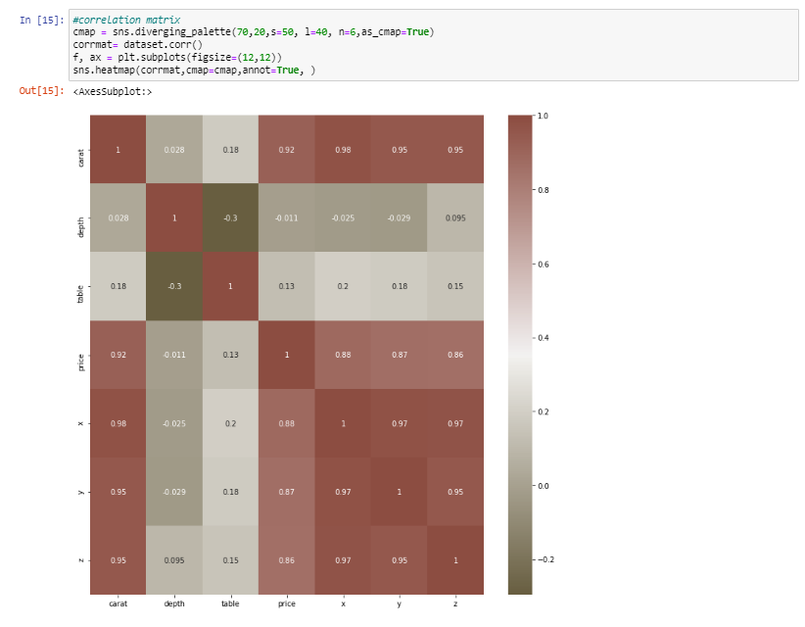
RESULTS & INSIGHTS
"x", "y" and "z" features show a high correlation to the target column (price) while "depth", "cut" and "table" show low correlation.
We could consider dropping but let's keep it.

Slide 17
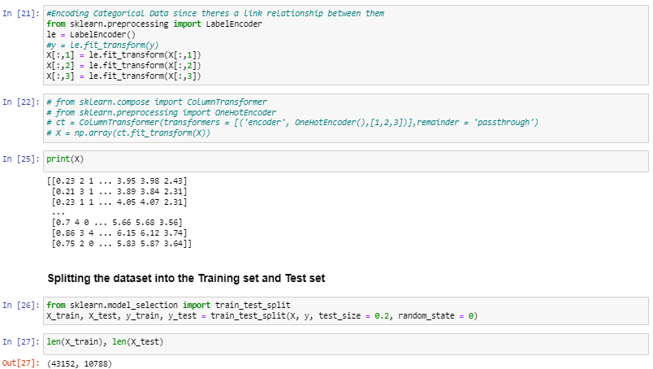
RESULTS & INSIGHTS
At this point, Label encoding was used to handle our categorical variables
The dataset was also split into train and test dataset.

Slide 18
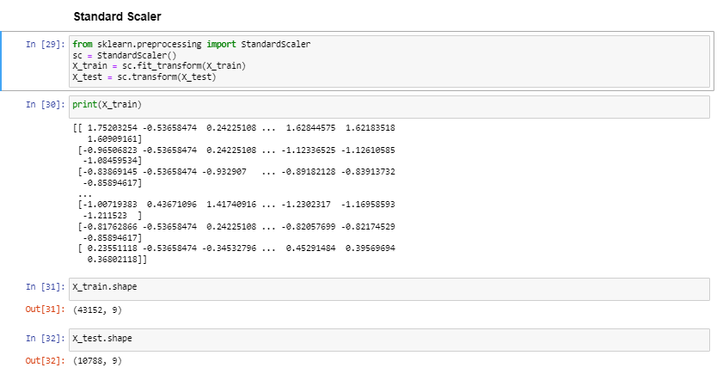
RESULTS & INSIGHTS
StandardScaler removes the mean and scales each feature/variable to unit variance.
It also help to solve the issue of outliers as seen in our dataset
In addition, its always advisable to scale your data while building a neural network model

Slide 19
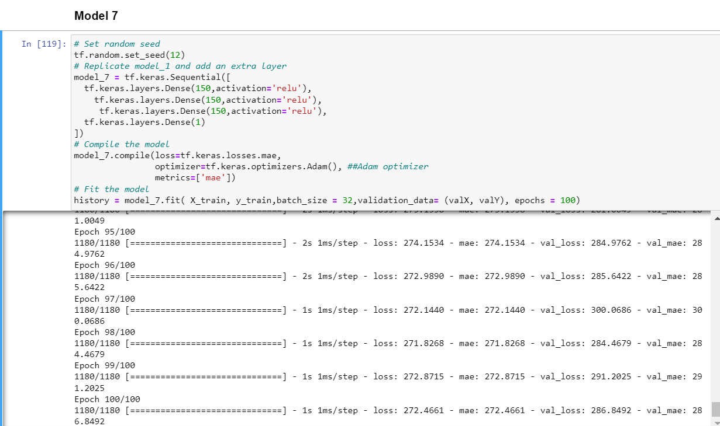
RESULTS & INSIGHTS
Model 7 gave the best result out of all the 8 models that was developed
This can be attributed to the increase in the dense units, additional hidden layers, using relu activation as well as the Adam optimizer

Slide 20
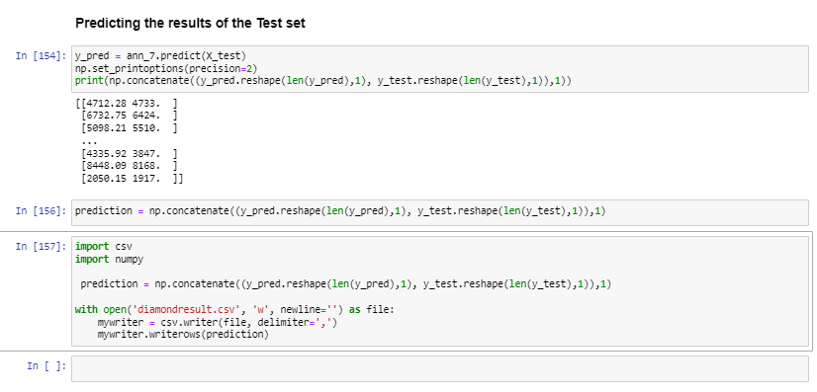
RESULTS & INSIGHTS
As shown on the visual displayed, the result of the test set was predicted based on the trained model.
After prediction, the result of the Prediction and Test data was compared and save as CSV file

Slide 21
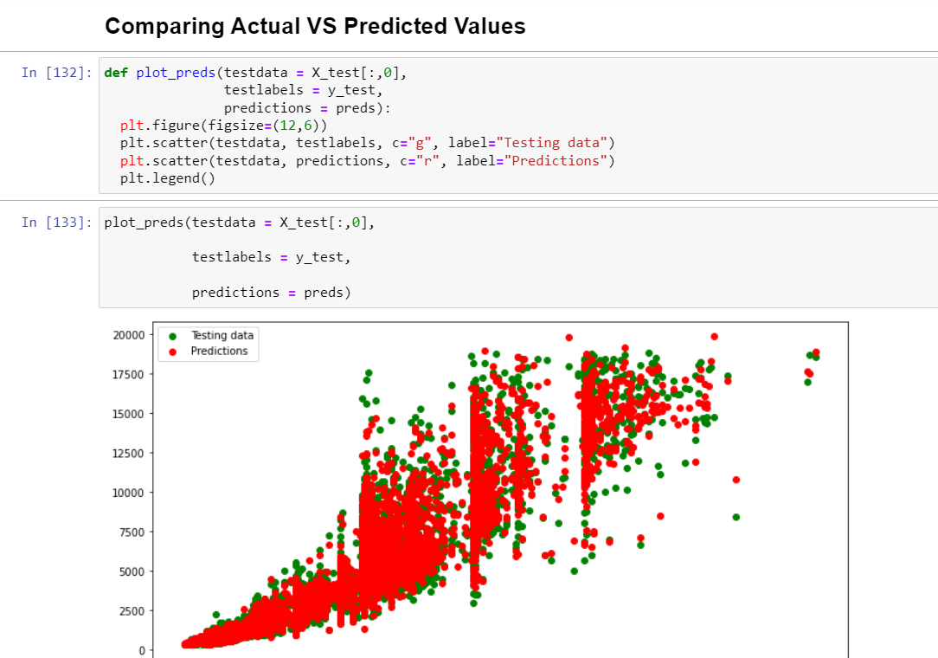
RESULTS & INSIGHTS
After prediction, the result of the Prediction and Test data was compared and save as CSV file
This is a snippet from the predicted result file.

Slide 22
CONCLUSION
Artificial Neural Network has been an efficient tool in predicting the prices of diamond.
During the parameters tuning process, it was also observed that Adam optimizer seems to be the best optimizer for this modelling,
Relu was most efficient as the activation function compared to others.
Adding more hidden layers and neurons also help improve the model capability to predict accurately and reduce the loss function.
It is also important to note that in as much as we had a very low mean absolute error for our prediction, there are still other classifiers like XGBoost that perform better than neural network when it comes to regression modelling.

